Slide 1
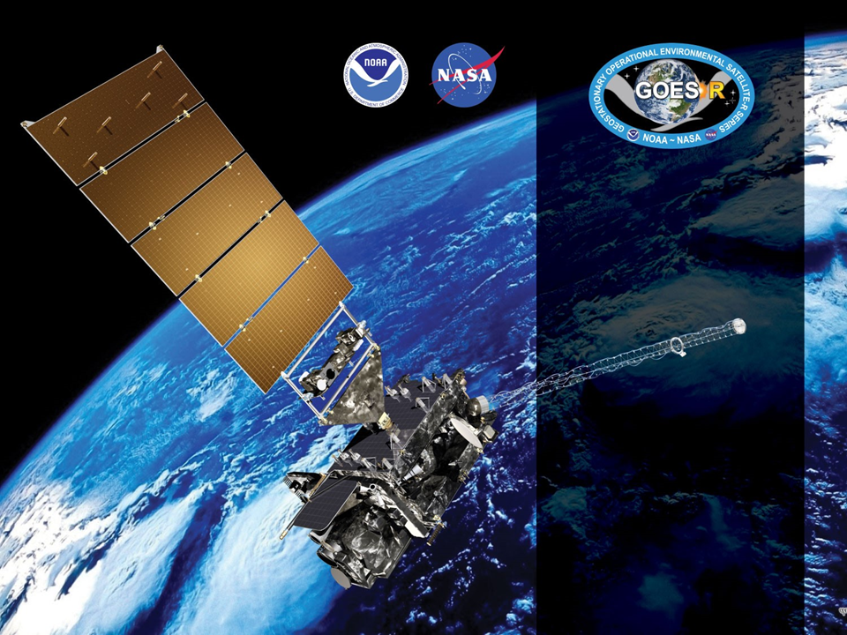
GOES-16 ABI L2+ Clear Sky Mask Provisional PS-PVR
February 16, 2018
GOES-R AWG
Andrew Heidinger*,
Denis Botambekov,
Jay Hoffman, William Straka, Steve Wanzong
NOAA/NESDIS/STAR*
and CIMSS

Slide 2
Agenda
Products Overview
PLPT Tests
PLPT Results
Product-related WRs and other issues
Beta Validation Product Maturity Assessment
Path to Operational
Summary and Recommendations

Slide 3
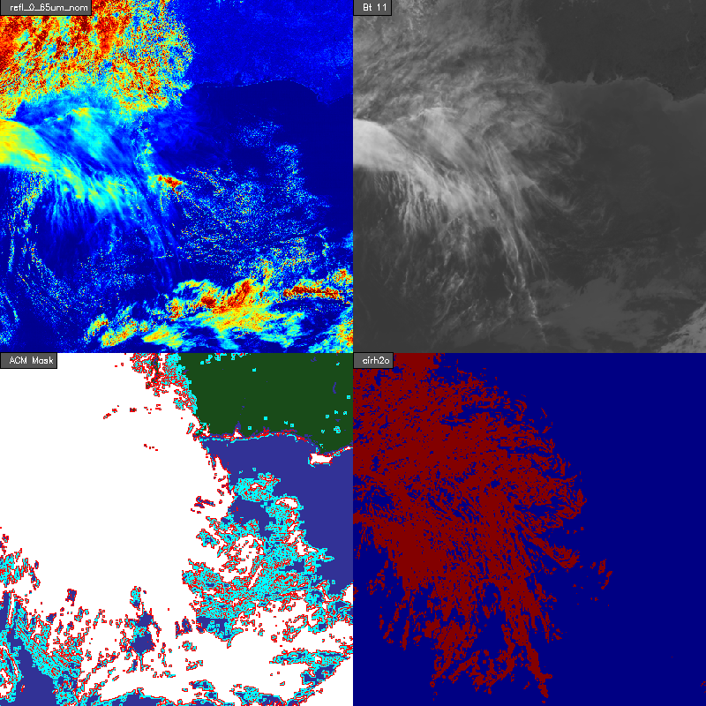
Product Overview
Cloud Mask:
Binary Cloud Mask (BCM)
4-Level Mask
Individual tests
All available on the data fabric.
Only BCM is available to external users.
Use varies by the algorithms. Some use BCM, 4-Level Mask or a subset of the individual tests.
Mask is self-consistent in that users can compute BCM and 4-Level Mask from the any or all of the bits.
4-Level Mask = (0) Conf. Clear, (1) Prob. Clear,
(2) Prob Cloudy, (3) Conf Cloudy

Slide 4
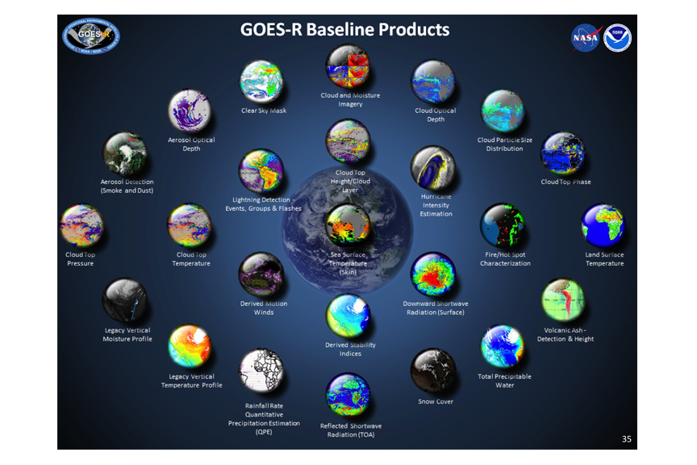
Products Impacted by Cloud Mask

Slide 5
Use of Cloud Mask
Team | Binary Cloud Mask | 4-Level Mask | Mask Tests | Other
Aerosol |  |  | X | X
Cryosphere | X | X |  | X
Sea Surface Temperature |  |  | X | X
Land Surface Temp. | X | X
Soundings | X | X
Radiation Bud. | X | X
Cloud | X | X
Winds | X
External Users | X
Note - In the Ground System code, the 4-level mask is read in to create a cloud mask within each algorithm
The analysis will focus on the Binary Cloud Mask (BCM). Even if the BCM meets its specification, issues may remain with the 4-Level Mask or the individual bits that are application specific.

Slide 6
Review of Beta
The BCM performed above spec for all all tests, except for Ocean day scenes in the CALIOP and SST analysis. Likely due to surface albedo issue (as noted in Beta presentation).
There were issues that were identified during the beta analysis which were fixed during the time period between beta and provisional.
Requested and received some feedback from teams and external users (NWS). Most issues were addressed via ADRs. However some feedback was just received recently and is undergoing investigation for a fix.

Slide 7
Path to Reaching Provisional
Risk Name | Description | Impact | Mitigation and Schedule
Ancillary data shift | Surface albedo data not being mapped correctly. This causes overclouding in the daytime tests, particularly | Major | ADR-237 was implemented on 17 April, 2017. Fix verified on DE output. Initial analysis of OE data shows fix has been implemented correctly.
Terminator stability test not being run | Terminator stability test currently not being run due to data not being available on data fabric | Minor | ADR-303 is currently schedule for integration on (5/5). Fix verified on DE output and AWG will verify fix when it is available on the OE.
Threshold updates | Thresholds will need to be trained and updated | Minor | Cloud Team currently is working to tune the thresholds to improve performance of the BCM
No continuous Mode 4 data available | No continuous M4 data available for testing. | Minor | Mode 4 test is currently planned for 21-24 April. AWG will verify fix during this time.
Large Reflectances | CWG has noted a 4% increase in reflectances on the visible channels post k-coefficient fix | Unknown | CWG is evaluating the increase in reflectance and working with PRO for resolution (ADR 301). AWG will evaluate any impact on BCM product one fix is available
Incorrect CRTM coefficients | The incorrect CRTM coefficients are being used in the GS. This has minor impacts on the thermal tests in the BCM | Minor | (ADR 192) is scheduled to fix this issue and is scheduled for implementation on (5/5). AWG will validate change in DE as well as fix when it is available on the OE.
Wrong Seebor emissivity and albedo data being used | Currently the GS is using the June Seebor and MODIS white sky albedo. While the impact on the BCM is minor, it is still an issue | Minor | WR 1828 is scheduled to fix this issue and is scheduled for implementation on June 2017. AWG will verify fix when it is available on the OE.
Fixed
Fixed
In progress
Fixed
In progress
Fixed
Fixed

Slide 8
PLPTs Under Review
PLPT ID | Descriptive Title | % Complete | Results | AWG POC
ABI-FD_CSM03 | Quantitative analysis of M3 FD CSM | 100 | Complete | AWG
ABI-CONUS_CSM03 | Quantitative analysis of M3 CONUS CSM | 100 | Complete | AWG
ABI-MESO_CSM02 | Quantitative analysis of M3 Meso CSM | 100 | Complete | AWG

Slide 9
Application of PLPT Quantitative Analysis Tests to each Domain
Our 3 PLPTs dealing with analysis are comprised of the same 4 methods.
Each contains the applications of these methods on the FD, CONUS and MESO domains.
The applications of each method to each domain is summarized below.
Some methods were redundant or not possible for some domains.
Analysis Method | FD | CONUS | MESO
Comparison to other Masks (MODIS)
SST Bias
SurfRad LST Bias
CALIPSO Lidar Comparison
Notes:
SurfRad LST data is only over CONUS, we found no reason to repeat with FD
We used tight-time constraints for MODIS comparisons and no MESOS or CONUSs were found.
MESO images that are in-sync with CALIPSO are rare.
MESO domains over ocean where not found.
No reason to repeat CALIPSO FD analysis on CONUS.

Slide 10
GOES-16 Data Used in this Review
We were advised to wait until January 1, 2018 to begin analysis.
Time series included data from whole record.
CALIPSO analysis ACMF used January 2 - January 13, 2018.
SST analysis used ACMF data from January 12 - January 31.
MODIS analysis used ACMF data from January 2- February 5.
SURFRAD analysis used ACMC data from January 12 - February 5.
CLAVR-x used to provide SDR data and other ancillary data to help display issues.

Slide 11
Provisional Requirements
Accuracy and precision of the CSM product has been assessed over a large and wide range of representative conditions
On a global basis the CSM shall meet all of its documented requirements, including the requirement of 87% correct detection (global requirement), for all modes; note the 87% requirement is only applicable under conditions where the (solar) zenith angle is equal or less than 70 degrees.
Remediation strategies are in place for known issues including those identified by downstream users.
Product is ready for potential operational use (user recommendation) and for use in scientific publications.

Slide 12
Qualitative Success Definitions
PASSED
No visual artifacts and/or Proportional Correct Detection (POD) near or above the specification of 0.87.
PARTIAL-PASSED
POD > 0.8 with or without visual artifacts. Dominant issues are known.
FAILED
POD < 0.8. Cause and solution of performance degradation is unknown.

Slide 13
Analysis of the GOES-R Cloud Mask

Slide 14
Analysis Methods Shown Here
As outlined in the RIMP, we will do the following.
Monitoring Cloud Fraction or ACMF and ACMC.
Comparison to NASA CALIPSO/CALIOP
Comparison to NASA MODIS Cloud Mask
Using fluxes at surface stations (SURFRAD) to diagnose performance.
Using SST Biases to diagnose performance.

Slide 15
Cloud Fraction Monitoring

Slide 16
Long-term Cloud Fraction Time Series
Fraction of Cloudy Pixels in GOES-16 (M3 & M4)
Drift
CONUS
ADR 237
ADRs 192 and 302
ADRs 426 and 465
ADR 512
Drift
FD
Notes:
Shows the fraction of GOES-16 pixels that are cloudy - not a cloud fraction. Pretty stable performance as expected. Outliers are getting rarer

Slide 17
Comparison with the NASA MODIS Cloud Mask

Slide 18
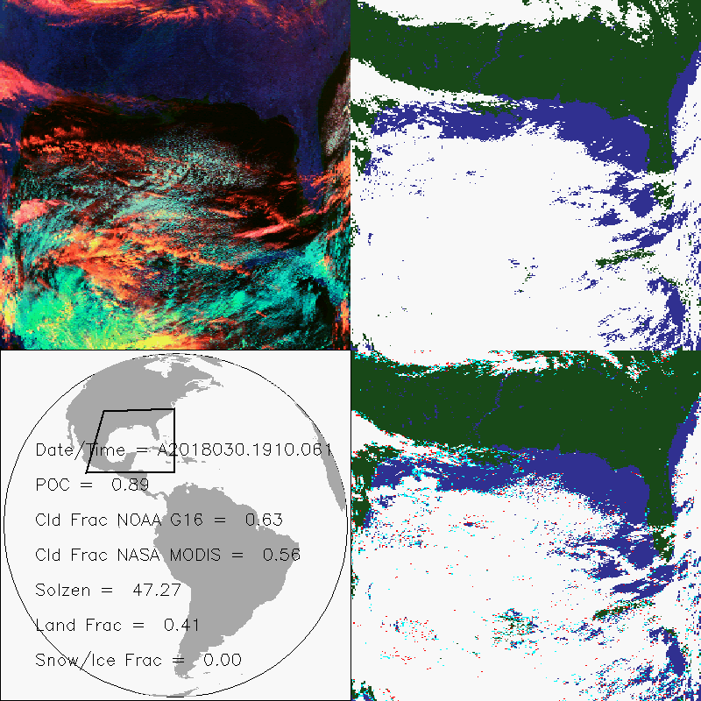
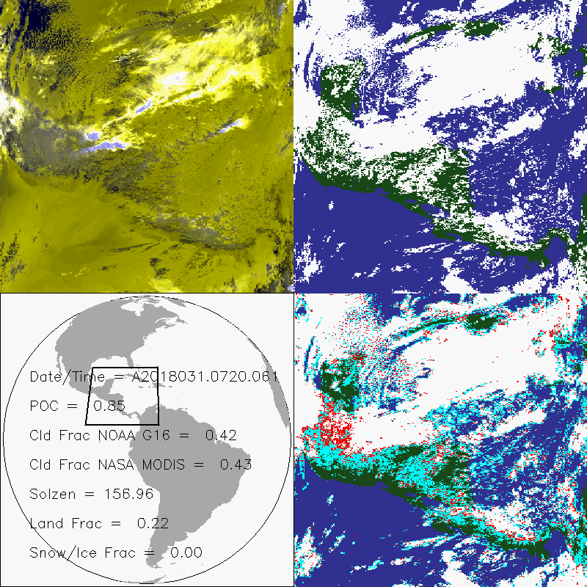
Comparisons to NASA MODIS Cloud Mask
We compared to NASA AQUA/MODIS (MYD36 C6.1) 4-Level Cloud Mask
January 12 - February 5, 2018
We mapped GOES-16 into the MODIS Granule.
Using MODIS as the reference, we computed Percent Correct (POC) and Cloud Fraction DIfference in each Granule.
Mean MODIS time - Mean GOES-16 time < 6 minutes.
Daytime Example
Nighttime Example
GOES-16
MODIS

Slide 19
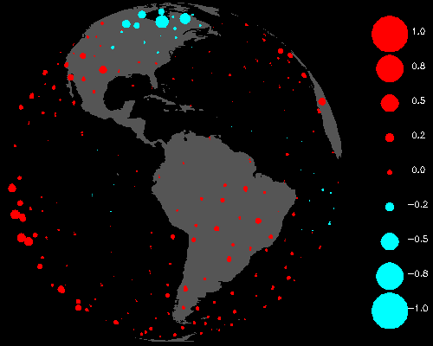
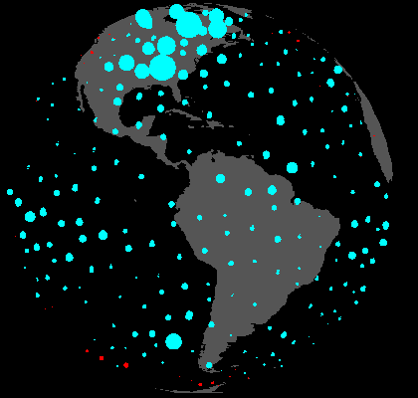
Summary of MODIS Comparison
G16 - NASA MODIS Cloud Fraction
Day
Night
 | Mean POC | % > Spec | % CF < 5% | % CF < 10% | % CF < 20%
Day | 0.87 | 51 | 54 | 85 | 97
Night | 0.82 | 31 | 31 | 61 | 92
All | 0.84 | 40 | 41 | 73 | 95

Slide 20
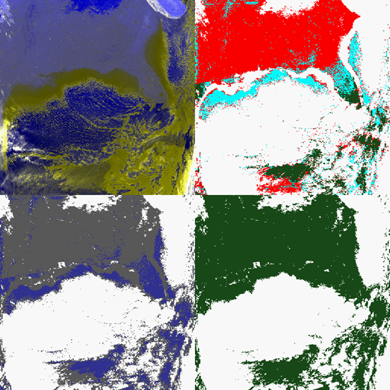
ABI-MODIS granule showing BAD agreement.
2018/004
07:35 UTC
Frac Diff = -0.352
POD = 0.598
MISS = 0.377
FALSE = 0.025
Failed

Slide 21
SST Bias

Slide 22
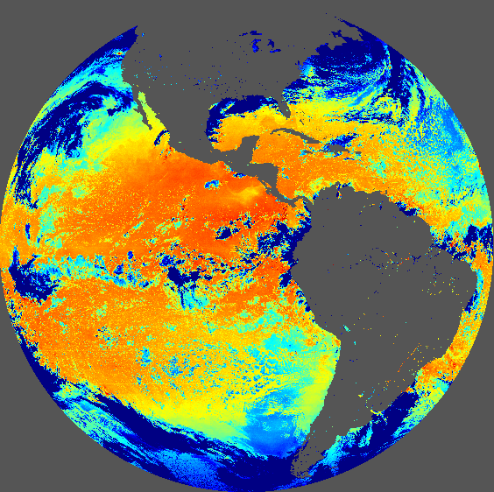
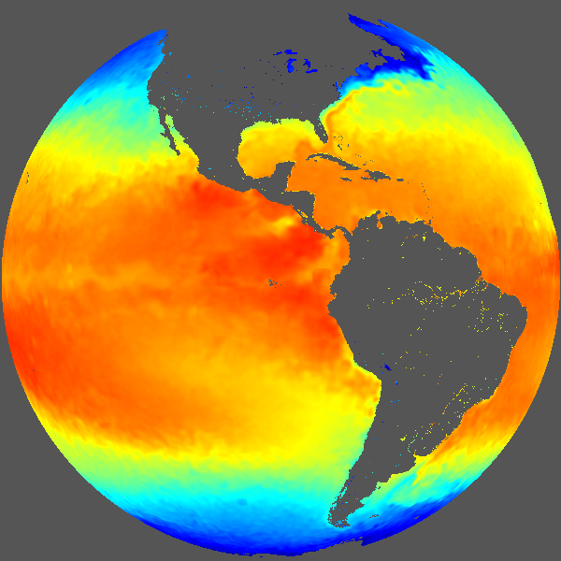
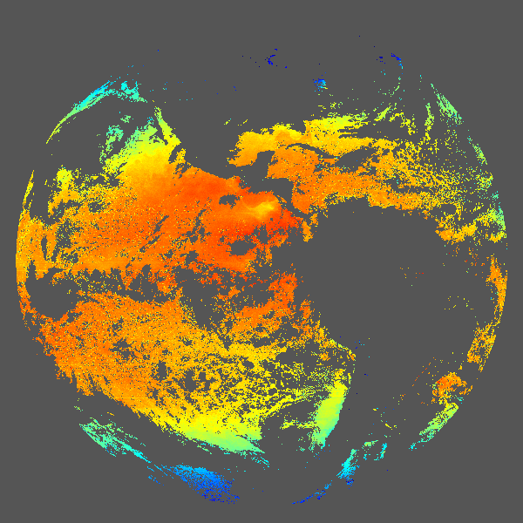
SST Comparison Description
Sea Surface Temperature (SST) is very sensitive to the presence of cloud.
If we compute SST for all pixels, we can compare observed SST to a background SST.
Clear pixels with negative SST biases are likely missed cloud.
Cloudy pixels with small SST biases are likely false cloud.
SST Unmasked
This analysis uses OISST.
SST computed using NLSST coefficients trained for this analysis.
Hourly GOES-16 FD for January 2018 used.
Not the GOES-16 SST Product.
OISST
Masked SST

Slide 23
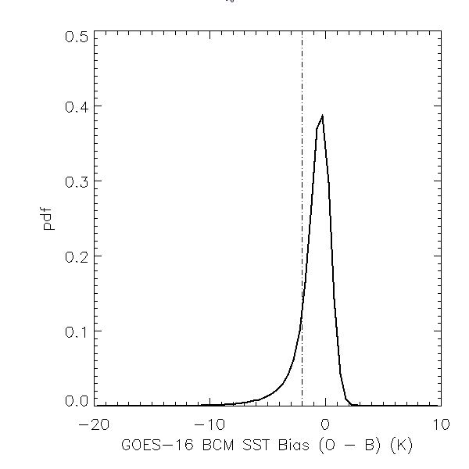
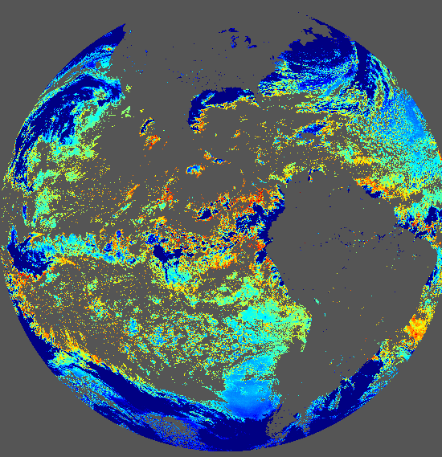
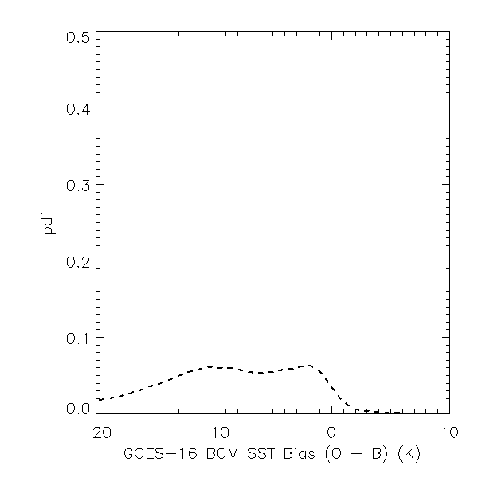
SST Comparison Description
O (observations)
B (background)
O-B (bias)
Clear
-2 K threshold
missed cloud
OISST
Cloud Masked SST
Cloudy
false cloud(?)
OISST
Clear Masked SST

Slide 24
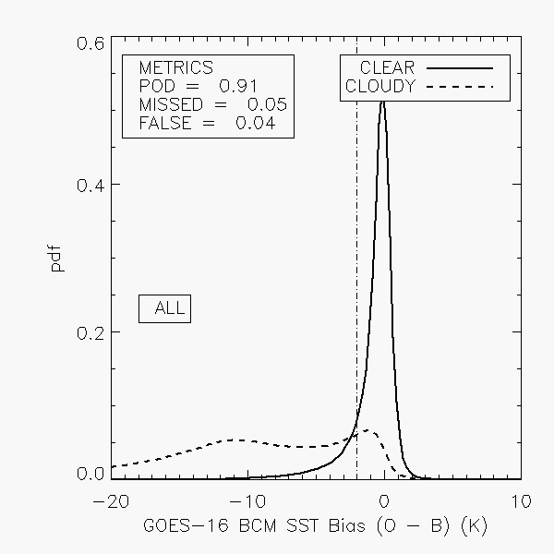
Cloud Mask Performance for Day Time
Solid line is the SST Bias distribution for clear pixels.
Dashed line is the SST Bias distribution for cloudy pixels.
Vertical line shows a bias of -2 K. A guess at the threshold for cloud contamination.
Clear pixels to the left of this line are considered missed cloud.
Cloudy pixels to the right of this line are considered false clouds.
Fix of 0.65 micron reflectance threshold improved this over Beta.
PASSED

Slide 25
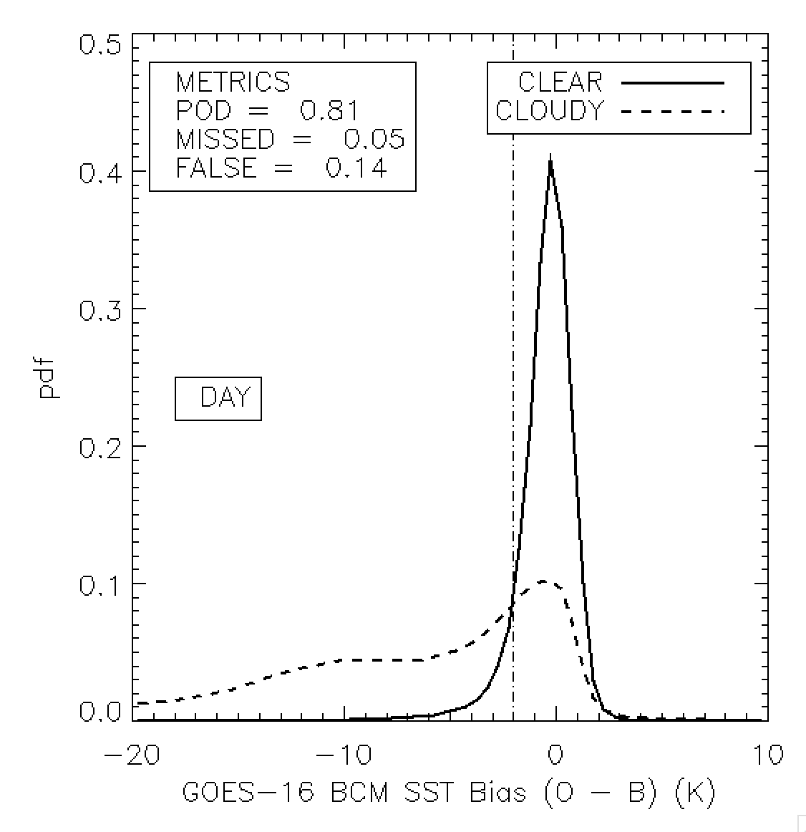
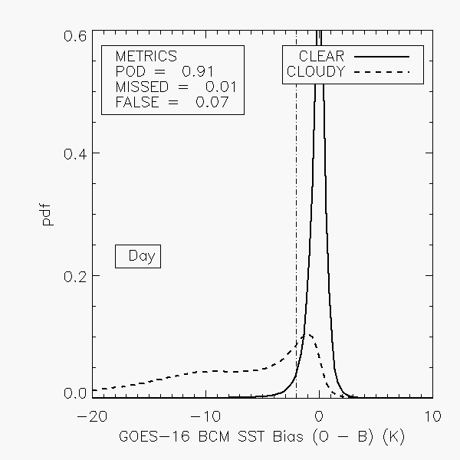
Beta to Provisional Comparison
“Day” shows an Improvement from 0.81 to 0.91 in POD (or PC)
Multiple Issues Addressed (White sky albedo and Calibration)
Beta
Provisional

Slide 26
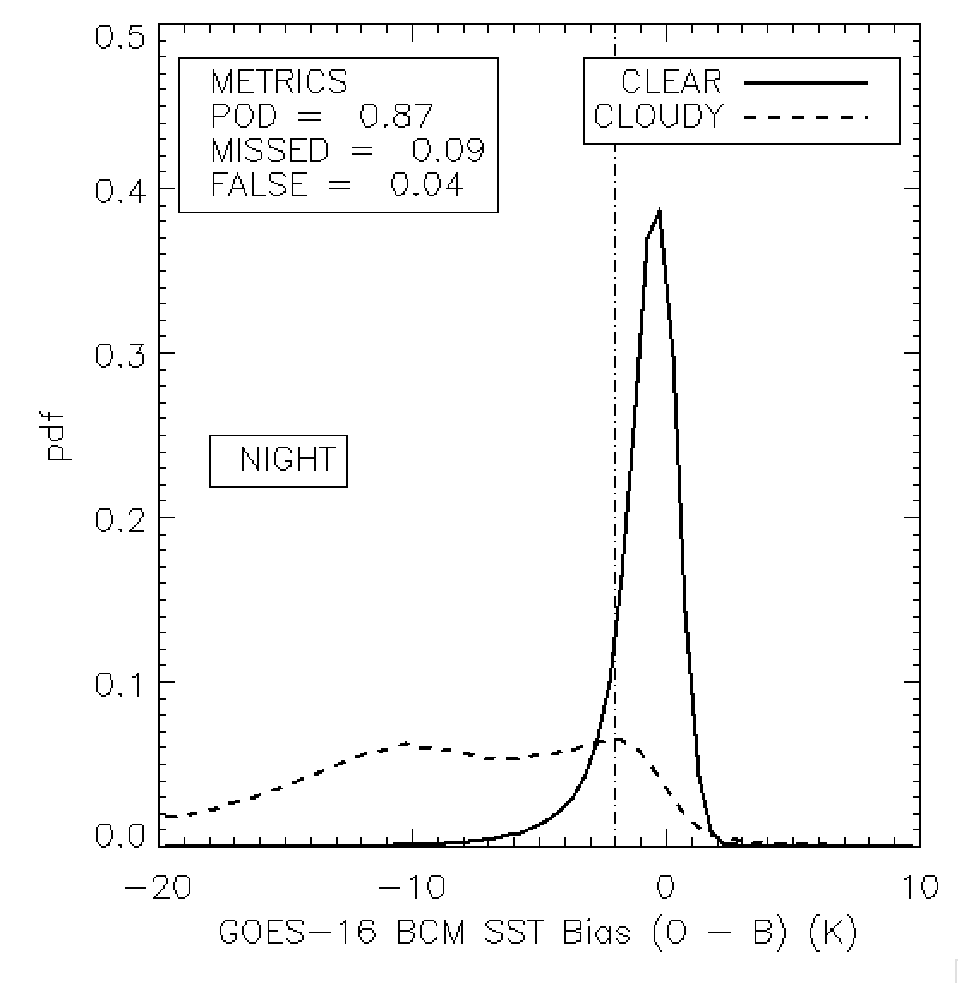
Beta to Provisional Comparison
Night shows an Improvement from 0.87 to 0.91 in POD (or PC)
Beta
Provisional

Slide 27
Cloud Mask Performance from SST Bias Summary
The SST analysis improved significantly since Beta.
The white-sky albedo mapping error fix is the likely culprit and the CIRREF change.
Nighttime performance lags daytime but that is expected.
Both meet specification at defined here.
Does not guarantee optimal performance of the clear-sky ocean products.

Slide 28
SurfRad Validation

Slide 29
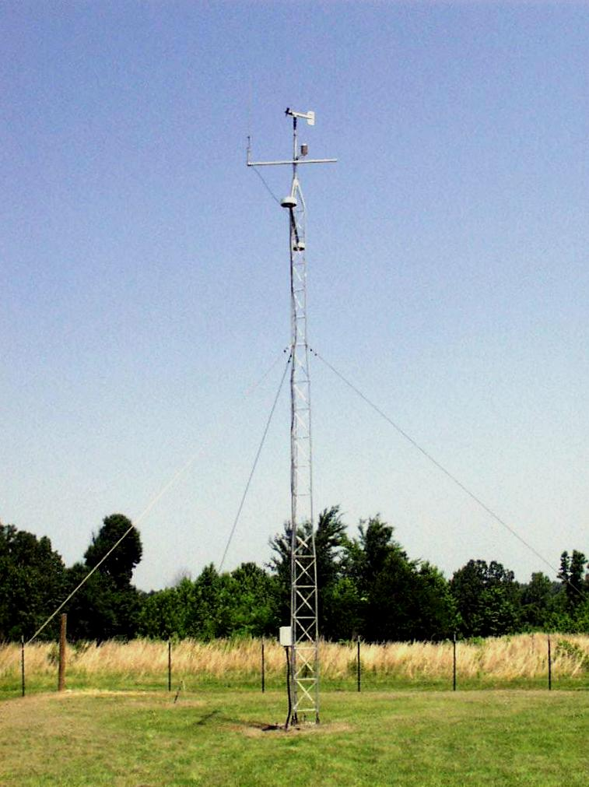
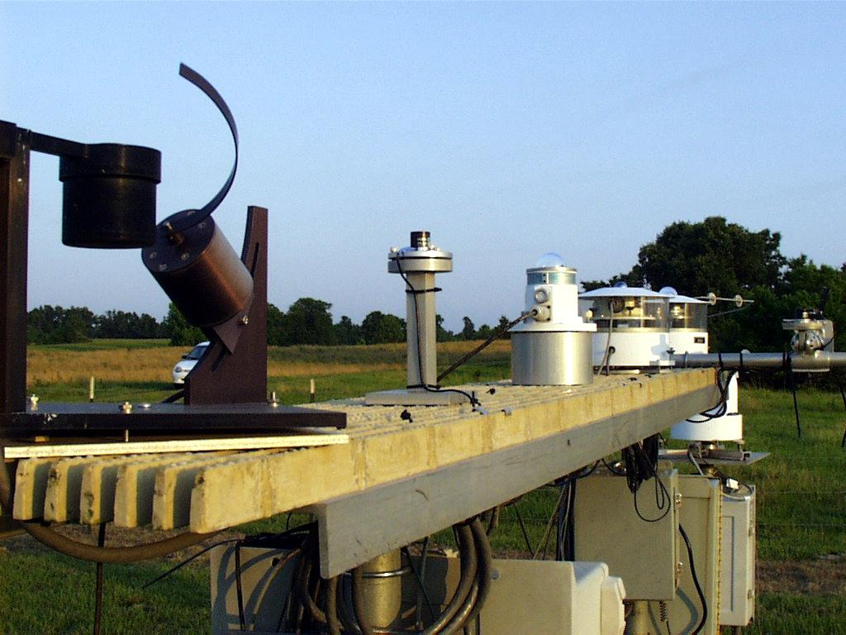
SurfRad Instruments (GWN, MS.)
Pyrgeometers measure broadband IR fluxes.
Down-looking Flux measures surface temperature which can be compared to satellite observations. Very sensitive to cold clouds - not to low warm cloud.
Up-Looking Flux is very sensitive to presence of low cloud.
Cloud is detected when
Downward flux > Predicted Clear Sky
Surface temperature > Observed GOES-16 LST
Down Looking Eppley Pyrgeometer
Up Looking Eppley Pyrgeometer

Slide 30
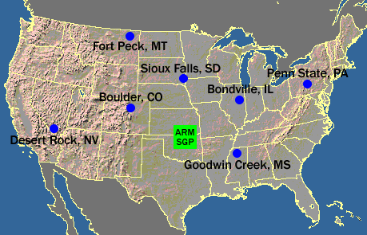
SurfRad Results
Data Period: January 12 - February 4, 2018. (Post CIRREF Fix)
Only CONUS data used.
3 sites in Western USA ignored.
PARTIAL-PASSED
Site | Percent Correct | Missed Rate | False Rate
Bon, ILL. | 0.91 | 0.02 | 0.06
Gwn, MS. | 0.92 | 0.06 | 0.02
PSU, PA. | 0.88 | 0.03 | 0.09
SXF, SD. | 0.82 | 0.10 | 0.08
Summary
Very little data to be definitive.
SXF may be impacted by the snow issue.
This analysis will provide seasonal skill estimates that are important.
Trying to get access to archive of Total-Sky-Imager estimates of cloud fraction which stopped being accessible in 2011.

Slide 31
Comparison to NASA CALIPSO/CALIOP Cloud Detection

Slide 32
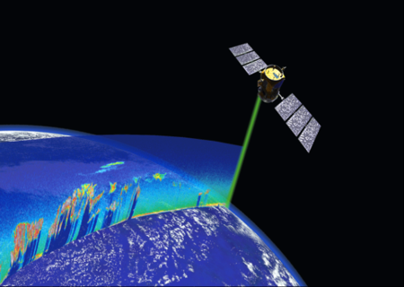
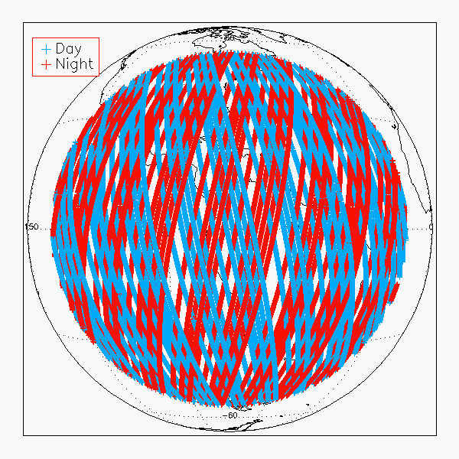
CALIOP vs ABI Comparison Description
https://www.globe.gov/web/calipso
CALIOP is a lidar on board of CALIPSO.
CALIOP Cloud algorithm results are considered as “Truth”.
11 days of CALIOP and ABI Matchup data are used 2018-002 and 2018-013
Filters applied to GOES-16:
Scan time difference ± 12 minutes,
Sensor Zenith Angle < 70.0
Filters applied to CALIOP
90N - 90S
COD = 0.0 or > 0.4
5km cloud fraction 0 or 1 (to avoid edges of cloud)

Slide 33
CALIOP vs ABI Comparison Statistics
Global, Day and Night, Any Surface
PASSED
Cloud Mask Algorithm | Sample Size | Cloud fraction |  |  |  | Probability of
 |  | CALIOP | ABI | Probab. Clear | Probab. Cloudy | Detection | False Detection | Missed Cloud
Baseline Cloud Mask accuracy requirement |  |  |  |  |  | 0.870
BCM HARRIS | 203412 | 0.699 | 0.672 | 0.000 | 0.000 | 0.903 | 0.032 | 0.065
BCM CLAVR-x | 203412 | 0.699 | 0.681 | 0.072 | 0.082 | 0.905 | 0.037 | 0.058
BCM Beta | 37975 | 0.598 | 0.617 | 0.000 | 0.000 | 0.891 | 0.064 | 0.045
Baseline Cloud Mask has the accuracy requirement of 87.0% for the end of the Provisional period. However, BCM performance already meets this specification over all surfaces.
CLAVR-x runs the “source” cloud mask that was delivered to Harris. It offers a way to verify the Harris implementation.
In the next slides we show BCM performance separately over certain surfaces and day/night .
* BCM HARRIS has no Prob Clear or Prob Cloudy

Slide 34
CALIOP vs ABI Comparison Statistics
Ocean, Day
PASSED
Cloud Mask Algorithm | Sample Size | Cloud fraction |  |  |  | Probability of
 |  | CALIOP | ABI | Probab. Clear | Probab. Cloudy | Detection | False Detection | Missed Cloud
Baseline Cloud Mask accuracy requirement |  |  |  |  |  | 0.870
BCM HARRIS | 48134 | 0.609 | 0.631 | 0.000 | 0.000 | 0.921 | 0.044 | 0.035
BCM CLAVR-x | 48134 | 0.609 | 0.627 | 0.057 | 0.031 | 0.922 | 0.041 | 0.037
BCM Beta | 12159 | 0.357 | 0.473 | 0.000 | 0.000 | 0.845 | 0.135 | 0.020
Ocean, Night
PASSED
Cloud Mask Algorithm | Sample Size | Cloud fraction |  |  |  | Probability of
 |  | CALIOP | ABI | Probab. Clear | Probab. Cloudy | Detection | False Detection | Missed Cloud
Baseline Cloud Mask accuracy requirement |  |  |  |  |  | 0.870
BCM HARRIS | 71028 | 0.656 | 0.648 | 0.000 | 0.000 | 0.899 | 0.028 | 0.073
BCM CLAVR-x | 71028 | 0.656 | 0.673 | 0.109 | 0.129 | 0.901 | 0.057 | 0.042
BCM Beta | 13929 | 0.693 | 0.655 | 0.000 | 0.000 | 0.906 | 0.028 | 0.066
* BCM HARRIS has no Prob Clear or Prob Cloudy

Slide 35
CALIOP vs ABI Comparison Statistics
Land, Day
PASSED
Cloud Mask Algorithm | Sample Size | Cloud fraction |  |  |  | Probability of
 |  | CALIOP | ABI | Probab. Clear | Probab. Cloudy | Detection | False Detection | Missed Cloud
Baseline Cloud Mask accuracy requirement |  |  |  |  |  | 0.870
BCM HARRIS | 20375 | 0.770 | 0.772 | 0.000 | 0.000 | 0.921 | 0.041 | 0.039
BCM CLAVR-x | 20375 | 0.770 | 0.783 | 0.054 | 0.040 | 0.923 | 0.025 | 0.052
BCM Beta | 3865 | 0.688 | 0.713 | 0.000 | 0.000 | 0.895 | 0.064 | 0.040
Land, Night
PASSED
Cloud Mask Algorithm | Sample Size | Cloud fraction |  |  |  | Probability of
 |  | CALIOP | ABI | Probab. Clear | Probab. Cloudy | Detection | False Detection | Missed Cloud
Baseline Cloud Mask accuracy requirement |  |  |  |  |  | 0.870
BCM HARRIS | 41357 | 0.824 | 0.768 | 0.000 | 0.000 | 0.926 | 0.006 | 0.068
BCM CLAVR-x | 41357 | 0.824 | 0.772 | 0.065 | 0.041 | 0.924 | 0.012 | 0.064
BCM Beta | 6427 | 0.834 | 0.784 | 0.000 | 0.000 | 0.939 | 0.005 | 0.056
* BCM HARRIS has no Prob Clear or Prob Cloudy

Slide 36
CALIOP vs ABI Comparison Summary
For 11 days CALIOP vs ABI collocation pixels BCM performance meets the accuracy specification requirement of 87.0%.
Indicated accuracy requirement should be met at the end of the Provisional period.
Cloud team is planning to tune BCM tests to increase performance, by using developed tools.
Notes:
Beta: the product is minimally validated and may still contain significant errors; based on product quick
looks using the initial calibration parameters.

Slide 37
PLPT Outcomes: Summary
All PLPT activities required to make Provisional have been completed.
Some PLPT on some Domains were not accomplished but no reason to believe this impacts performance.
Unexpected behavior revealed by PLPTs, under investigation:
Snow mask usage
PFMFT/ETROP along coast lines
RFMFT false cloud on sst fronts
Once these issues are fixed, tuning can begin to optimize performance against our PLPT methods. (i.e. tuning will address terminator artifacts)
Subsequent modifications will be based on team feedback.

Slide 38
GOES-16 Cloud Mask User Applications and Feedback

Slide 39
GOES-16 ASR Assimilation
GOES-R³ funded a project to deliver GOES-R Infrared Radiances to NOAA/NWS NCEP for assimilation into the GFS model.
GOES-16 Cloud Mask and Cloud Pressures are used.
Jim Jung and Sharon Nebuda (CIMSS) are working with Andrew Collard (NCEP) to test the GOES-16 GS products.
Walter Wolf and Thomas King are developed to BUFR file creation and delivery mechanisms.
Most important external application of GOES-16 Cloud Mask.

Slide 40
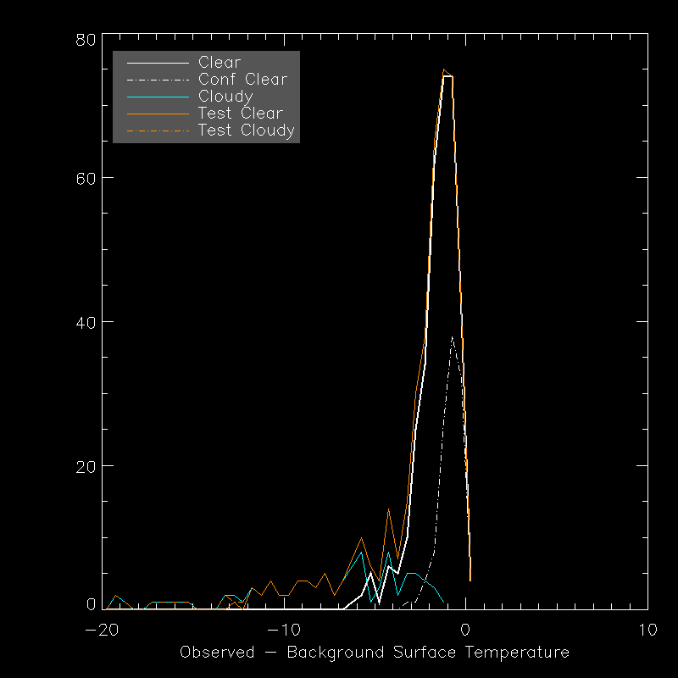
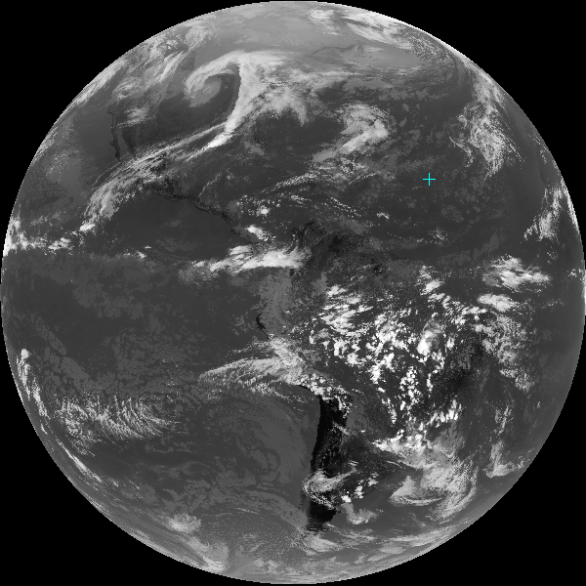
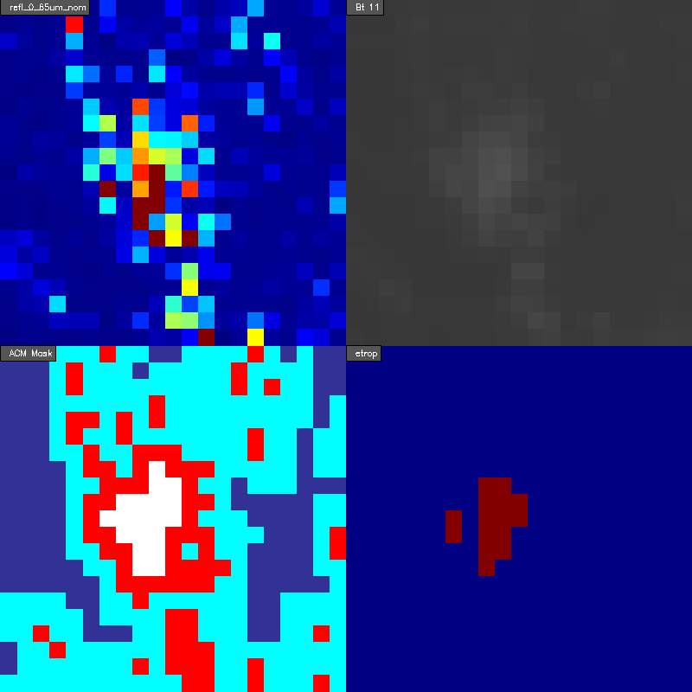
How GOES-16 ASR Works
ASR provides statistics of clear IR radiances in grid-cells to NCEP
GOES-16 Full-Disk Image
O-B for the ASR Grid-Cell
0.65 um Ref
11 um BT
Cloud Mask
Single Cloud Mask Test
NCEP GSI
Single ASR Grid-Cell

Slide 41
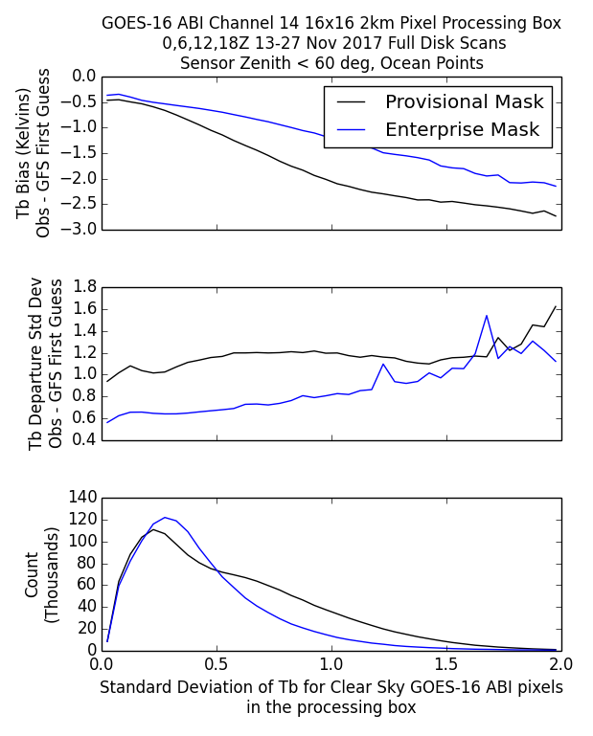
GOES-16 ABI Infrared Radiance for
NCEP GFS Data Assimilation System
NCEP plans to use ABI IR Radiances for assimilation within GDAS
At this time, IR Radiance assimilation is considered for clear sky observations
Removing Cloud impacted data is vital to the data quality for use in assimilation
GDAS departures demonstrates an increasing bias for an increase in observed standard deviation within the CSR/ASR processing box
Using the Enterprise mask results in reduced departure bias and standard deviation.
Enterprise mask allows an increase in counts for radiance data with smaller standard deviations in the processing box (better cloud clearing)
Notes:
NCEP GFS/GDAS currently uses clear sky infrared radiances for data assimilation. The quality of the product is inherently dependent on removing cloud impacted data. Preliminary results of side by side comparison of the provisional G-16 cloud mask and the Enterprise cloud mask do show an improvement in cloud clearing for the newer mask. The GOES-16 infrared radiance product extent and quality will benefit from the update in the cloud mask algorithm.
Comment from Andrew Collard: the Enterprise cloud mask appears to reduce the incidence of undetected cloud and it's use would increase the chances of positive impact on the analysis from the CSR product.
Brightness Temperature for the processing box is an average of the clear sky pixels.

Slide 42
GOES-16 Sky Cover
GOES-16 Cloud Properties including cloud mask are used in the production of the Sky-Cover Product (SCP).
SCP is current delivered to NCEP “operationally” from CIMSS (Jordan Gerth).
Used in RTMA.
SCP uses Enterprise Cloud Algorithms - needs some non-baseline products.
Feedback is positive but we need to involve the NCEP RTMA activities in future planning.

Slide 43
Review of Issues since Beta

Slide 44
Instrument/GPA Issues Identified Pre-launch and Resolution Status
Title | Description | Status | Mitigation
WR2702 | ABI Cloud Mask (ACM) Algorithm Metadata Issues | OPEN | WR2702, DO.06
Notes:
PRO Fills this In

Slide 45
Instrument/GPA Issues Identified Post-launch and Resolution Status
Title | Description | Status | Mitigation
ADR237 | Errors in daytime visible cloudmask tests | Closed | Installed in OE on 4/17
ADR192 | CRTM Coefficient Updates | Closed | Installed in OE on 5/5
ADR302 | Cloudmask Terminator Issue | Closed | Installed in OE on 5/5
WR1828 | Wrong Seebor emissivity and albedo data being used | In_Work | Implementation June 2017
ADR-465 | RGCT and RFMFT land threshold updates | Closed | Installed in OE on 11/27
ADR-426 | Fix to Nearest Warmest Center issues around coastal regions | Closed | Installed in OE on 11/27
ADR-512 | Cirrus reflectance Test update and TPW fix | Closed | Installed in OE on 1/9
ADR-532 | Continued blocks in GS implementation of RFMFT test | Under investigation | Currently under investigation by PROPASS and AWG
ADR-575 | Use of Snow Mask | Under investigation | Currently under investigation by PROPASS and AWG
Notes:
PRO Fills In

Slide 46
Product Maturity Assessment
Preparation Activities | Assessment
Initial calibration applied (L1b) | N/A
Rapid changes in product input tables / algorithms can be expected | Several updates are planned within the next two weeks to resolve minor issues found during Beta assessment
Product quick looks and initial comparisons with ground truth data not adequate to determine product quality | Data looks good following the PLPT tests
Anomalies may be found in the product and the resolution strategy may not exist | There are a few minor issues, however, we have a path forward on all the minor issues discovered.
End State | Assessment
Products are made available to users to gain familiarity with data formats and parameters | Agree
Product has been minimally validated and may still contain significant errors | True
Product is not optimized for operational use | True

Slide 47
Cloud Mask Fixes
Implemented in GS since Beta
Risk Name | Description | ADR # | Implementation date | Additional comments
Ancillary data shift | Surface albedo data not being mapped correctly. This causes overclouding in the day time tests, particularly | ADR-237 | 17 April, 2017
Terminator stability test not being run | Terminator stability test currently not being run due to data not being available on data fabric | ADR-303 | 5 May, 2017
Threshold updates | RGCT and RFMFT land Thresholds updated | ADR-465 | 27 November, 2017 | RFMFT blocks within land still exist. ADR-532 is investigating issue within GS
Nearest warmest center | Fix to NWC test to fix issues around coastal regions | ADR-426 | 27 November, 2017
Cirrus Reflectance Test | Update to Cirrus reflectance test | ADR-512 | 9 January, 2018

Slide 48
Update #1 - Ancillary Data
Shift (ADR-237)
Initial analysis showed daytime BCM shows significant over clouding
Analysis shows that the reason for this is a shift in the static MODIS white sky albedo as evident from looking at the visible (RUT, RGCT, RVCT) cloud Mask tests
Further analysis (following slides) the shift is due to the GS using a static white sky albedo map for the GOES-E (75W) position instead of Central.
Fix implemented on the OE at 15:50 UTC on 17 April, 2017

Slide 49
Update #2 – Terminator Stability
Test (ADR-302)
Initial analysis showed that the Terminator Stability test in the BCM is not being run based on observations of BCM bits stored in the BCM Intermediate Product File.
Will impact BCM performance in terminator region
The TERM_THERM_STAB is described in the ACM ATBD (section 3.4.1.2.8) and ACM ADD (Section 3.18).
Fix implemented on the OE on May 5, 2017

Slide 50
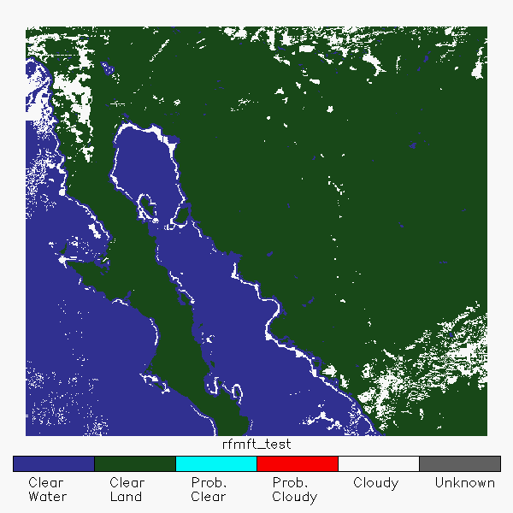
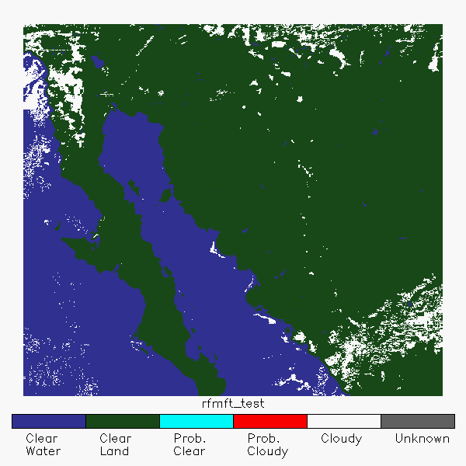
Update #3 – Nearest Warmest
Center (ADR-426)
Coastal artifacts were identified during the summer season that were caused by the RFMFT and ULST tests. The primary issue was identified as the inclusion of pixels marked as coast in the calculation of the Nearest Warm Center (NWC).
A corrective fix was implemented to NWC calculation to remove costal pixels from the determination of the NWC pixel and cycle over missing NWC pixels in the RFMFT and ULST tests
In the GS, issues with non-coastal pixels is still not completely resolved and under investigation
Fix implemented on the OE on 27 November, 2017
Original RFMFT
RFMFT
w/ fixed NWC

Slide 51
Update #4 – RFMFT and RGCT
Threshold Updates (ADR-465)
BCM showed artificial (False) clouds over land in the RGCT test due to larger than expected reflectances in the 0.64μm channel.
Solution was to multiple the existing per pixel threshold by 1.5 to account for this
Cloud mask remains sensitive to this issue. If/when the channel calibration is fixed, we need to drop the thresholds again or risk missing significant amounts of cloud.
The RFMFT land threshold was updated to 1.2 to remove artifacts not caught by NWC coast mask fix.
Fix implemented on the OE on 27 November, 2017

Slide 52
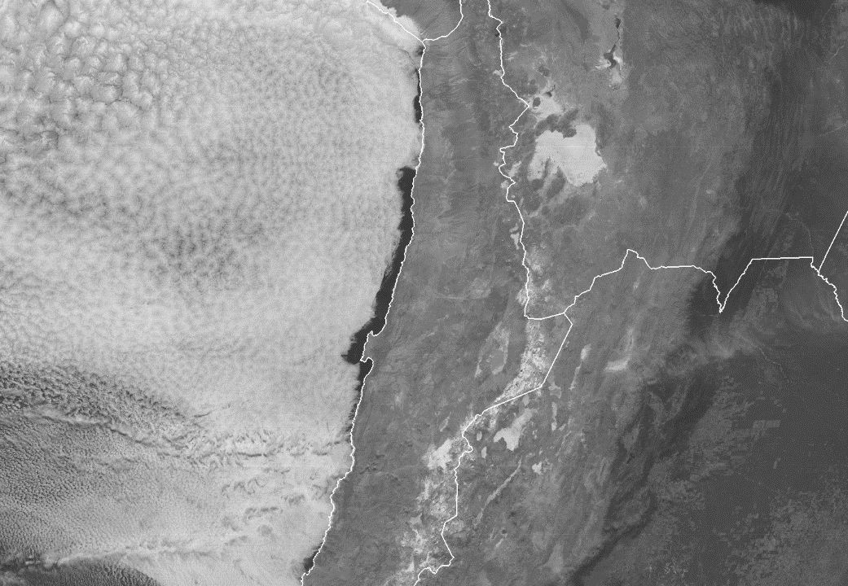
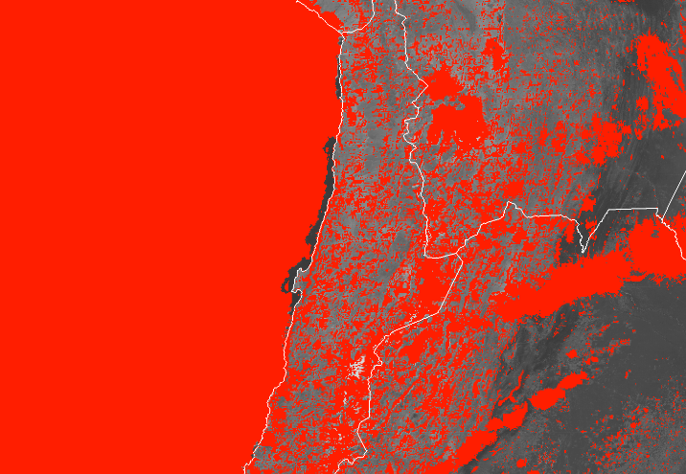
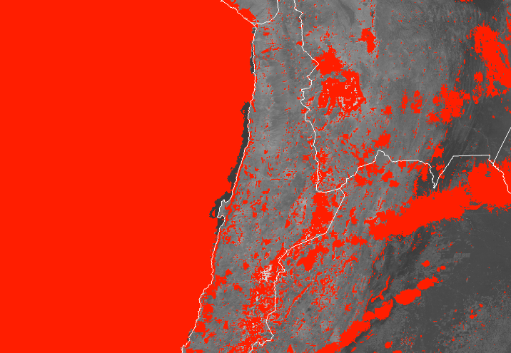
Update #4 – RGCT Threshold Update Example
Cloud mask remains sensitive to this issue. If/when the channel calibration is fixed, we need to drop the thresholds again or risk missing significant amounts of cloud.
ABI Band 2 (0.64μm) Reflectance
19 July, 2017 @ 1800Z
Original Threshold
X1.5

Slide 53
Update #5 – Cirrus reflectance Test and TPW fix (ADR-512)
Updated Cirrus Reflectance test to include updated science found with utilizing 1.3µm channel
Calculated pseudo-white sky albedo for 1.3µm channel replaces static threshold for test.
Calculation revealed issue with TPW units (mm vs cm) in BCM (and other algorithms) within the GS. This was critical for the CIRREF test to work properly.
More accurately detects cirrus which was missed in previous tests
Fix implemented on the OE on 9 January, 2018 at 2100 UTC.
Following slides depict the improvement of the new CIRREF Test over the original test and then shows it was properly implemented in the GS, using a FD image.

Slide 54
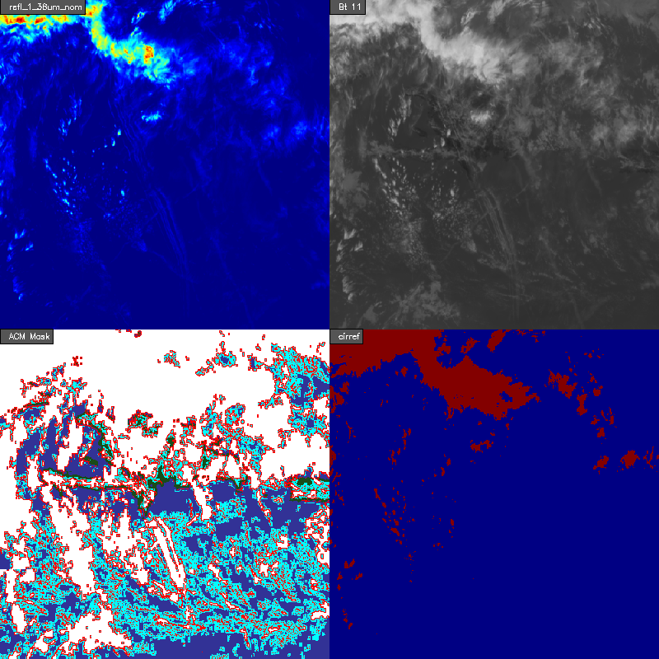
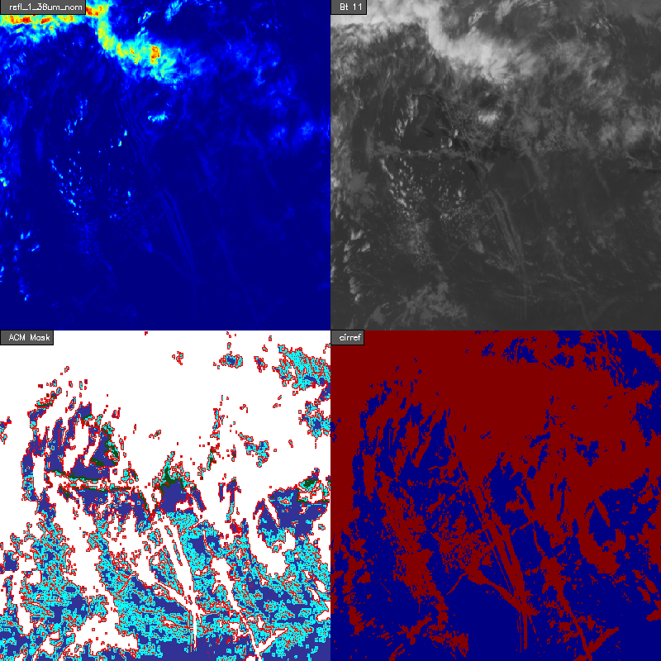
Example of CIRREF Change
1.38 um Ref
Old
11 um BT
1.38 um Ref
New
11 um BT
Cloud Mask
CIRREF
Cloud Mask
CIRREF
CIRREF now detects more cloud and this does impact final mask.

Slide 55
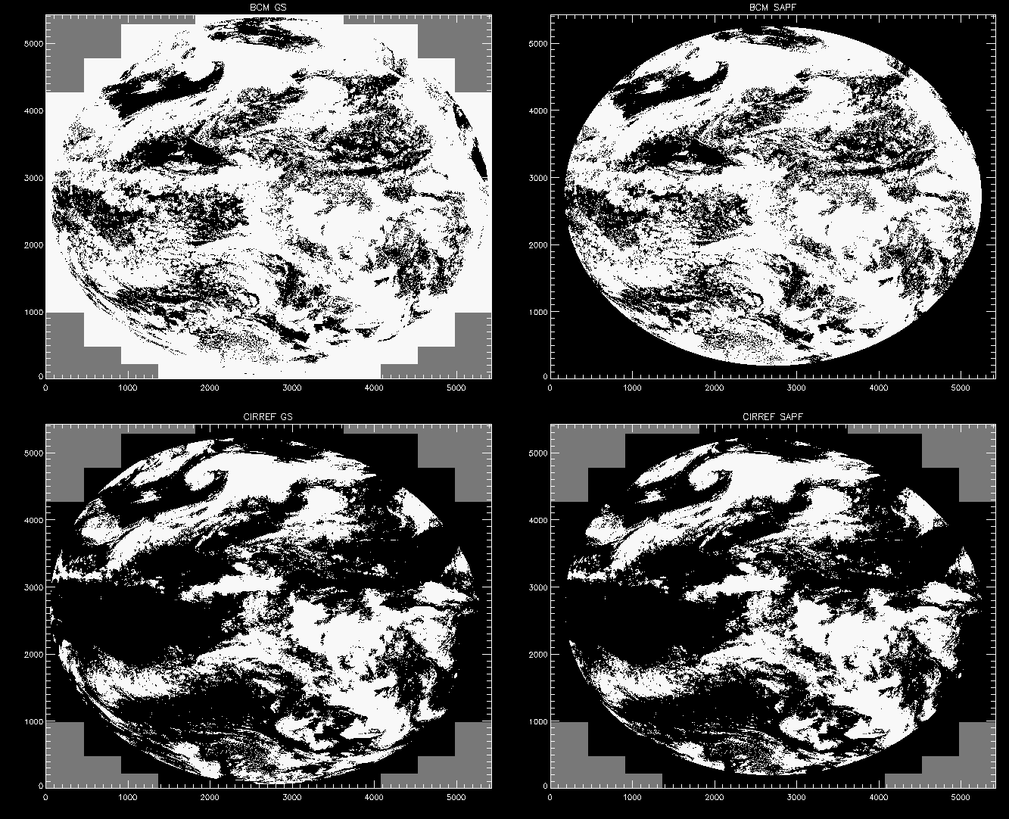
Update #5 – Cirrus reflectance Test and TPW fix (ADR-512)
Ground System
Offline System (SAPF)
BCM
CIRREF

Slide 56
Provisional PLPTs
Test ID | Test Title
ABI-FD_CSM04 | Assess the accuracy and precision of the CSM product over a large and wide range of representative conditions
ABI-CONUS_CSM04 | Same as for ABI-FD_CSM04 except for CONUS
ABI-MESO_CSM04 | Same as for ABI-FD_CSM04 except for MESO
AWG Cloud Mask Team will conduct these tests to further evaluate the L2 Cloud Mask product quality.
Full test plans and procedures are given in the INST Readiness, Implementation, and Management Plan (RIMP v1.0; 416-R-RIMP-0337)

Slide 57
New Issues

Slide 58
Risks to Reaching Full Validation
Risk Name | Description | Impact | Mitigation and Schedule
Application Optimization | Our analysis of the BCM does not capture the specific uses in the downstream applications | High | Cloud team is actively polling teams for feedback and will fold all feedback into its tuning and testing activities.
Threshold/Test updates | Thresholds will need to be trained and updated. Some tests need to be reworked due to issues identified during operations | Moderate | Cloud Team currently is working to tune the thresholds and identifying issues in various tests to improve performance of the BCM
Snow Mask usage | An issue with the snow mask usage was identified by a user and is currently being evaluated | Moderate | Currently under investigation by AWG and PROPASS. Suggest inclusion of ndsi-based internal snow mask modification.
Large Reflectances | CWG has noted a 4% increase in reflectances on the visible channels post k-coefficient fix | Moderate | CWG is evaluating the increase in reflectance and working with PRO for resolution (ADR 301). AWG will evaluate any impact on BCM product one fix is available. Ad hoc tuning done to address will need to be removed once calibration is corrected.
RFMFT test false cloud | The relative split-window test is causing some false clouds | Low | Explore use of this test by teams. Explore test modification or replacement.
Terminator Issues | We see day/night differences in cloud detection that manifest as visual artifacts in the mask. | Low | Work with impacted team (LST, Sounding) and tune as necessary.
Missed Low Cloud | We see a non-negligible fraction of missed cloud at night. | Low | Work with impacted teams to access impact. Explore tuning and test modification.

Slide 59
Issue #1 – False Cloud Over
Snow (ADR 575)
It was reported by NWS that the BCM was falsely detecting clouds where snow was present. This report resulted in ADR 575
Investigation by the AWG found that this issue was limited to just the GOES-R Ground System and not to any of the offline processing systems (CLAVR-x and SAPF)
Resulting investigation showed the issue was due to the IMS/SSMI snow mask (default snow mask in the GS) missing snow.
Examples on following slides show example case from Bill Line (NWS) from 22 January 2018

Slide 60
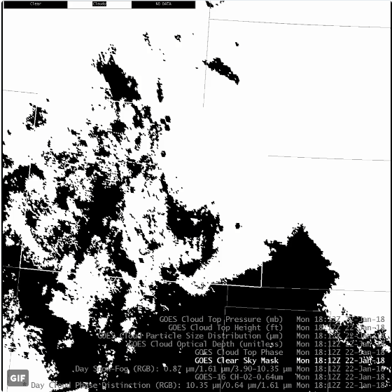
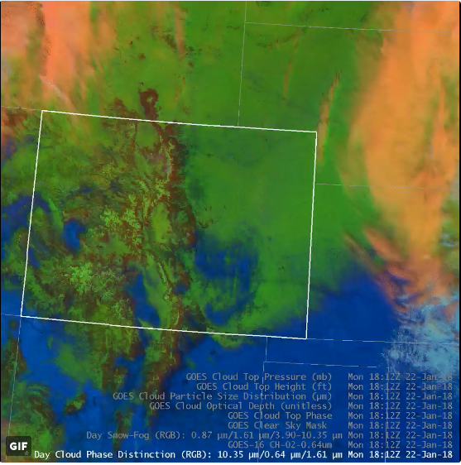
Issue #1 – False Cloud Over
Snow (ADR 575)
On 1/22/18, Cloud Mask reported a plethora of false cloud over Colorado.
This was discussed in a tweet from Bill Line NWS/Pueblo
Clear Sky Mask
RGB (Snow=Green, Cloud=Orange)
False Cloud

Slide 61
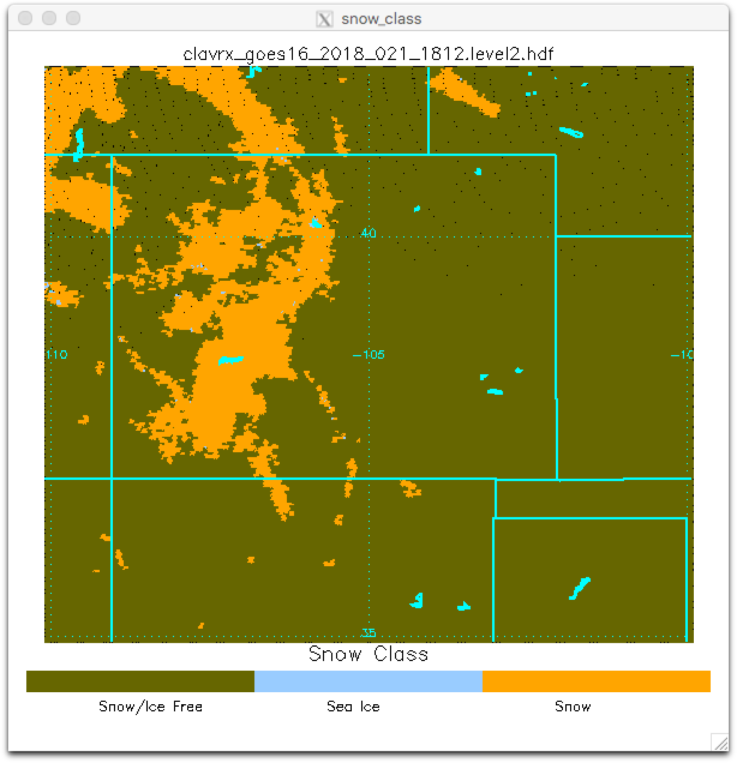
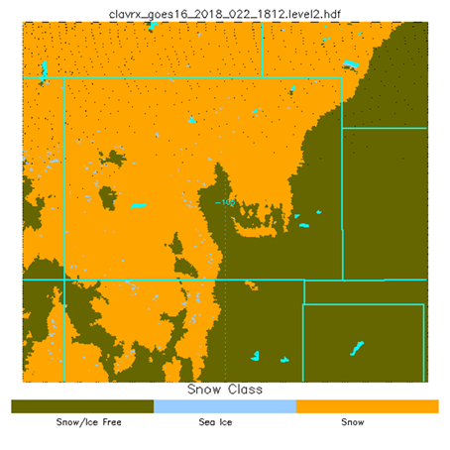
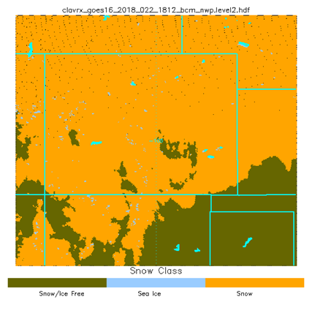
ADR 575: Snow Mask Differences
Cloud Mask will detect cloud falsely during the day if the snow mask misses snow
Colorado received a lot of new snow on 1/22
IMS snow field created on 1/21 used for 1/22
GFS snow field is also available to the Harris GS and might have been a better this day.
IMS Snow Field 1/21
IMS Snow Field 1/22
NWP (GFS) Snow Field 1/22

Slide 62
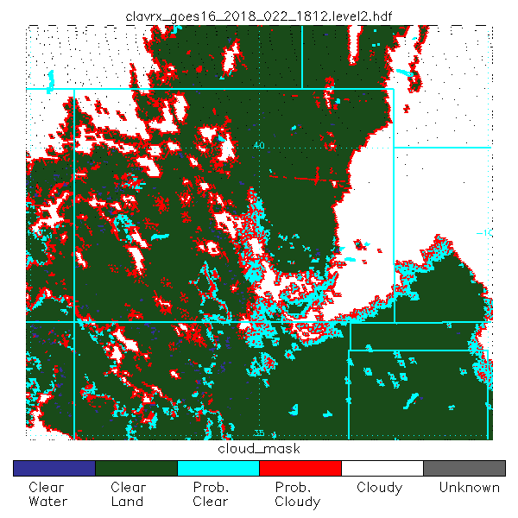
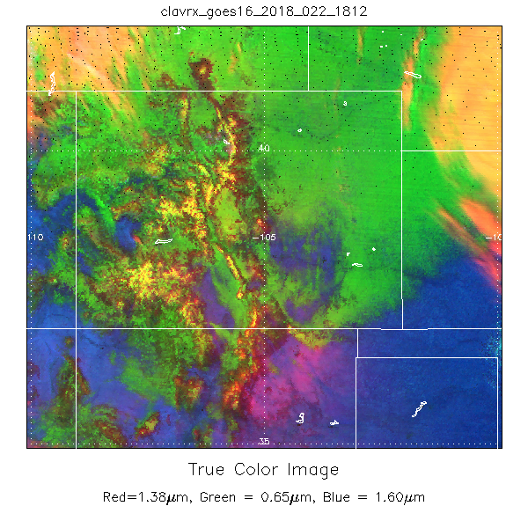
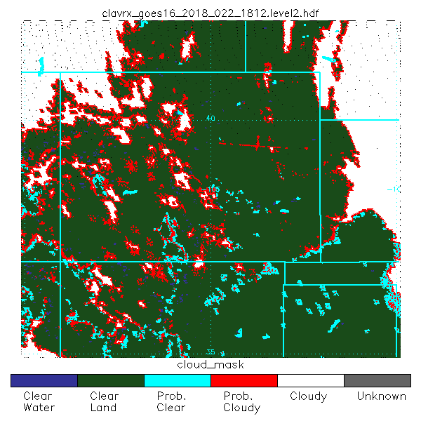
Dependence of Daytime Cloud Mask on Ancillary Snow Mask
Snow mask is used to turn off reflectance tests that are sensitive to snow.
These example illustrate how missing snow in the ancillary input will impact the cloud mask.
IMS
GFS

Slide 63
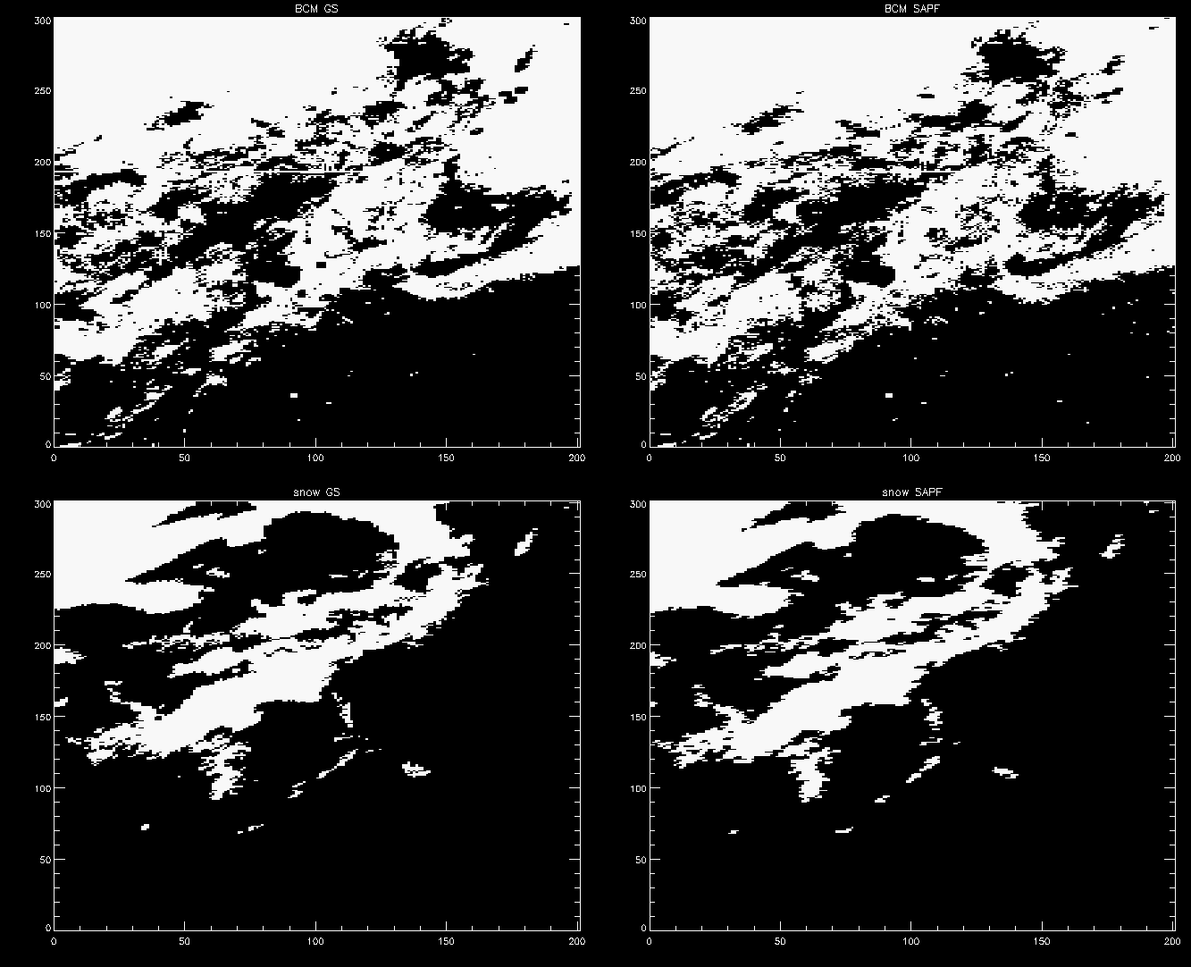
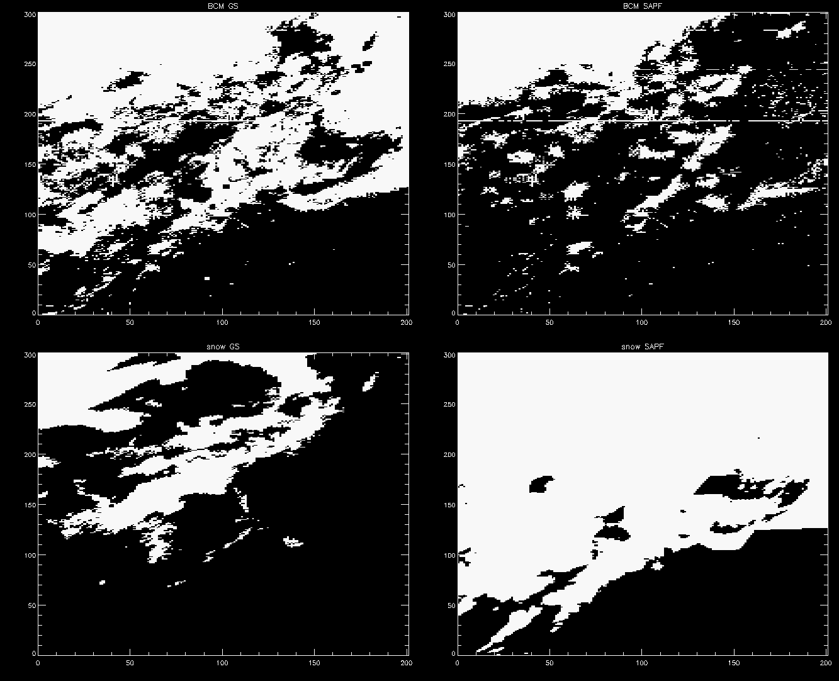
Issue #1 – False Cloud Over
Snow (ADR 575)
Verification of the actual snow / cloud information from 1/22 case
Snow bit from BCM IP file and SAPF output file
Ground System
IMS/SSMI
Offline (SAPF)
IMS/SSMI
Offline (SAPF)
GFS
BCM
Snow Bit from BCM IP file
Circled area indicates “false cloud” region marked on slide 65

Slide 64
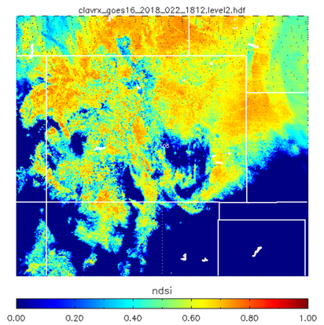
ADR 575: Snow Mask Differences
One possible solution is to add an Normalized Differential Snow Index (NDSI), which is already being calculated within the BCM, as an additional snow mask within the BCM
As this image shows from 1/22/2018, use of the ndsi could have helped resolve the snow mask ancillary data issue.
The Cloud AWG, working with PROPASS and ASSIST, will evaluate and provide a solution when/if it is ready
GOES-16 NDSI (high = snow)
IMS Snow Field

Slide 65
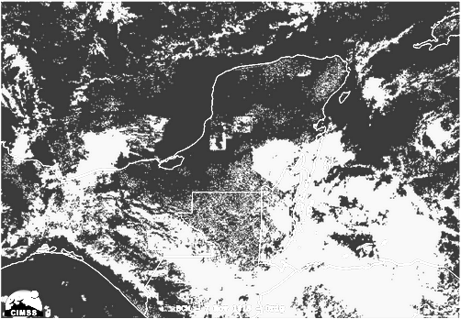
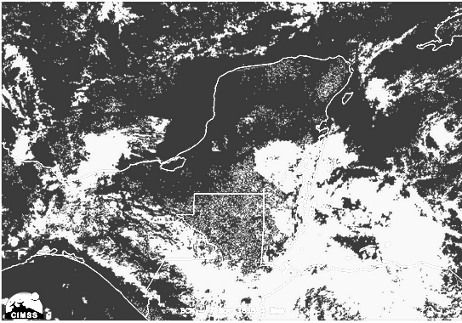
Issue #2 – Continued Blocks
in RFMFT Test (ADR 532)
PROPASS identified continued blocks in the RFMFT test even after the implementation of ADR-426 and ADR-465, which notionally fixed the issue
Investigation by the Cloud AWG found that this issue was limited to just the GOES-R Ground System and not to any of the offline processing systems (CLAVR-x and SAPF)
PROPASS and Cloud AWG will be investigating this issue to determine the cause in the GS and solution.
Ground System
Offline System (SAPF)
Notes:
Main thing to point out is that the GS has the blocks in the Yucatan and the SAPF (same thresholds, etc.) does not have the blocks.

Slide 66
Other Issues not covered by an ADR

Slide 67
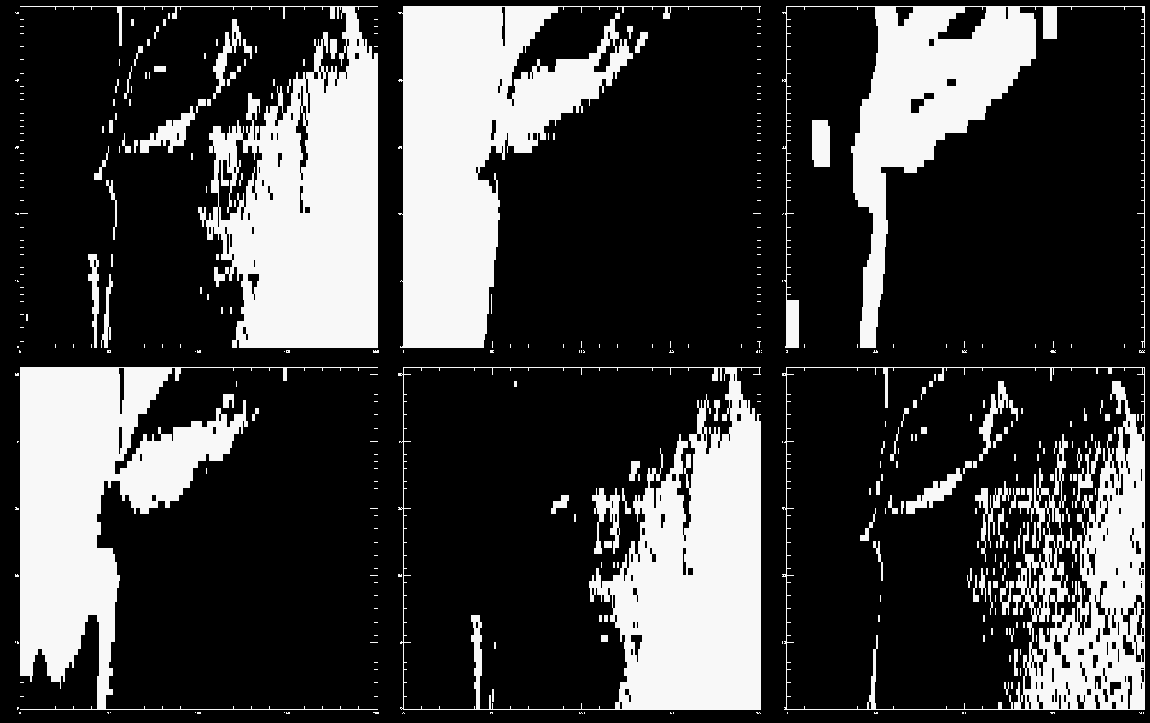
Issue #3 – Missed/false clouds over
strong land/water temperature gradients
It was found that along the coastal boundaries of relatively warm water and very cold land, that false cloud was being detected. These issues were initially being masked by the RFMFT issue which was resolved.
Initial findings suggest that it is the PFMFT and ETROP test causing false clouds along the coasts
The AWG will investigate and determine a solution.
Example case shown on next slide from 3 Jan 2018 at 0000Z, zoomed in over New York and New Jersey
BCM
Land/Water
Coast
False cloud on Delaware River due to ETROP
Coastal artifacts due to PFMFT
Snow
ETROP
PFMFT

Slide 68
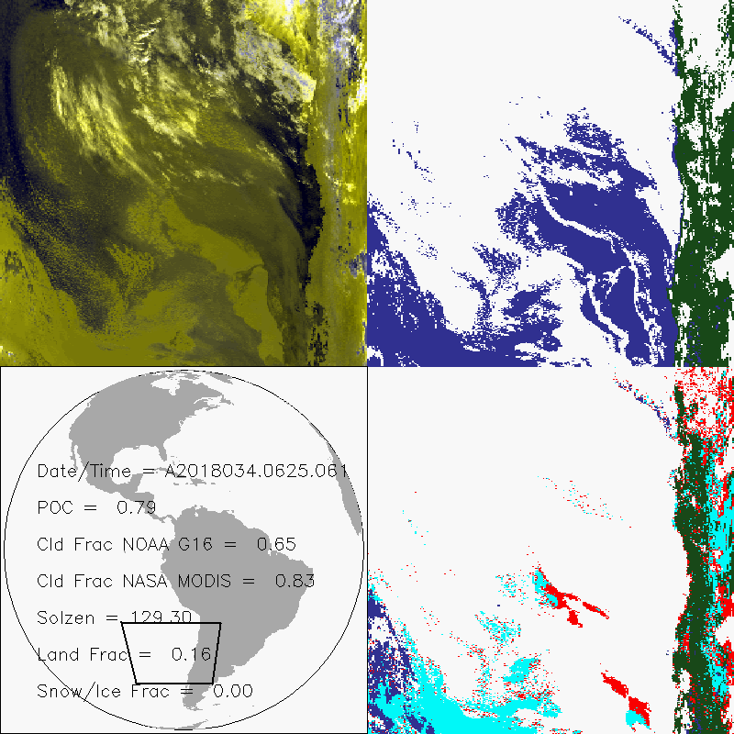
Missing Warm Cloud at Night
Current mask can miss the detection of very warm low cloud at night.
Cloud mask uses a 3.75 - 11 micron test that also involves clear-sky radiative transfer.
This is likely our largest missed-cloud issue.
We will try and optimize this test further.

Slide 69
False Cloud from RFMFT over
SST Fronts
January 22, 2018 18:15 UTC
Here is an example of a false cloud from the RFMFT.
RFMFT looks at split window differences over a small region.
It is being fooled by SST gradients.
False Cloud

Slide 70
Terminator Performance
January 31, 2018
We see terminator effects because day/time tests come on and off.
We do not see any impact on performance (POC) at the terminator times.
We do have a terminator test that attempts to mitigate this and we attempt to tune as allowed/warranted.
Not a major issue for us unless a team requests a specific fix.
Notes:
The point of this slide is acknowledge the presence of terminator issues but to show that mask performance - at least over the ocean - is not impacted. We are not a climate product. Day-night differences are ok if the teams get what they want.

Slide 71
Conclusions

Slide 72
Recommendation for Provisional Maturity
Provisional: product performance has been demonstrated through a large, but still (seasonally or otherwise) limited, number of independent measurements. The analysis is sufficient for limited qualitative determinations of product fitness-for-purpose, and the product is potentially ready for testing operational use.
Cloud AWG Team therefore recommends that the Binary Cloud Mask data be transitioned to Provisional status at this time.
All tests appear to working
Major flaws can be attributed to known issues that will soon be resolved.
A minimal amount of validation was done successfully.
L1B issues are not impacting our performance significantly.
PASSED

Slide 73
Path to Full Maturity
We expect to apply the same PLPTs to be conducted for Full Maturity
We are gathering an archive of golden days where we save L1,L2 and IPs.
Our goal is 10 golden days spread throughout March to November 2018.
we hope to continue to engage the teams and feedback from users to begin application-specific analysis.
We will take advantage of opportunities for threshold adjustments.
Will participate in the International Cloud Working Group (ICWG) comparisons.
Notes:
can add as many slides as needed. Large importance

Slide 74
Summary
AWG recommends that Binary Cloud Mask data be transitioned to Provisional status at this time.
AWG has found these issues that will addressed before Full Validation
Snow mask usage
Remaining RFMFT blocks
False Cloud (PFMFT/ETROP tests along coast lines)
Missed Cloud (warm low stratus at night)
Terminator Performance
User Feedback will determine if these issues will impact Full Validation Maturity.

Slide 75
Backup Materials

Slide 76
Beta to Provisional Comparison
“All” shows an Improvement from 0.84 to 0.91 in POD (or PC)
Beta
Provisional

Slide 77
SURFRAD Comparisons
Case study: Jan 3-5, 2018, all 7 sites, 5-minute data frequency (4746 datapoints)
Mean GOES-16 clear surface temperature bias -3.3°K
Percent correct: 85.8% based on Tscf bias less than +/- 5°K
Weakness
Coastlines
Great Lakes
Terminator regions
Cloud edges
Cold surfaces
Over snow & river (ice)
At night
PARTIAL SUCCESS

Slide 78
PLPT ABI-FD-CSM-03:
BCM Full Disk
January 03rd, 2018, 1630Z
False Color RGB
R=0.64µm, G=0.86µm, B=11.0µm (rev)
or
R=3.9-11.0µm, G=3.9-11.0µm, B=11.0µm (rev)
PASSED

Slide 79
PLPT ABI-CONUS-CSM-03:
BCM CONUS
January 03rd, 2018, 1832Z
False Color RGB
R=0.64µm, G=0.86µm, B=11.0µm (rev)
or
R=3.9-11.0µm, G=3.9-11.0µm, B=11.0µm (rev)
PASSED

Slide 80
PLPT ABI-MESO-CSM-03:
BCM M1
January 03rd, 2018, 1505Z
False Color RGB
R=0.64µm, G=0.86µm, B=11.0µm (rev)
or
R=3.9-11.0µm, G=3.9-11.0µm, B=11.0µm (rev)
PASSED

Slide 81
PLPT ABI-MESO-CSM-03:
BCM M2
January 03rd, 2018, 1722Z
False Color RGB
R=0.64µm, G=0.86µm, B=11.0µm (rev)
or
R=3.9-11.0µm, G=3.9-11.0µm, B=11.0µm (rev)
PASSED

